Slide 1
Book of Daniel Class 8 – Chapter 7 Winter 2023
What characteristics have we seen of ungodly men and Godly men?
What is the main point of Chapters 1-7?

Slide 2
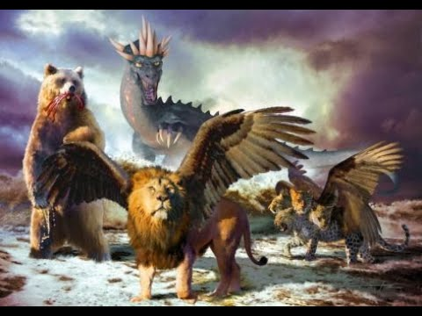
Daniel 1-6
Ungodly Men | Godly Men
Full of Strife | Bold
Uncontrolled Anger | Faithful
Worldly Strong | Strong
Selfish and Self- Centered | Fellowship
Haughty in Spirit | Meek
Worldly Wise | Wis
 | Courageous

Slide 3
Daniel – Rough Outline
Style
Ch 1-6: Story
Ch 7-13: Vision
2. The King’s Dream
7. Daniel’s Dream
3. The Fiery Furnace
6. The Lion’s Den
4. Nebuchadnezzar’s Pride
5. Belshazzar’s Pride
8. Daniel’s 2nd Vision
1. Recruited to Serve in Babylon
9. Daniel’s Prayer
10-12. Daniel’s 3rd Vision
HEBREW
ARAMAIC
HEBREW

Slide 4
The Book of Daniel (Structure)
Style:
Ch. 1-6: Story
Ch. 7-12: Vision
Ch. 1 Hebrew
Ch. 2-7
Aramaic
Ch. 8-12
Hebrew
Language:
Prologue
God rules in the kingdoms of man.
God preserves His sacred people.
Theme:
We are still in this section

Slide 5
When are we in Daniel 7

Slide 6
Daniel 7 – Daniel’s Dream
Let’s read the text together…

Slide 7
Daniel 7- Vision of the Four Beast

Slide 8
Daniel 7:1-12
How would we interpret this vision in light of the connection to chapter 2?
How is this vision different from the dream of Chapter 2 and why is that significant?
Difference on the 4th beast?

Slide 9
Daniel 7:13-28
What does Daniel see coming from the clouds?
What is Daniel’s reaction to what he is seeing- vs 15 and vs. 28?
What is the main point of this entire vision?

Slide 10
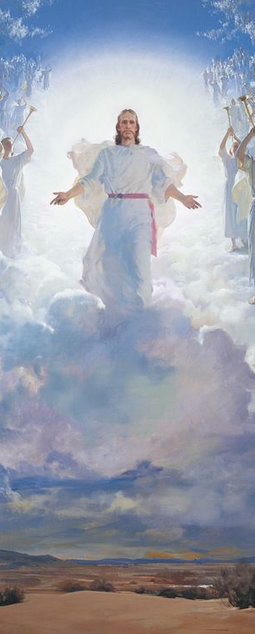
Daniel 7 Alarm us? Comfort us? Sober us?
Vs 27
Isaiah 9:6-7
Ephesians 1:20-21
Hebrews 1:3-4

Slide 11
Daniel 2-7: The Aramaic Section
Let’s review before the final section in Aramaic next week. Summarize the stories & identify the connecting lesson.
Story:
Lesson:
Story:
Ch. 2
God reigns in man’s world
Ch. 7
Dream statue = kingdoms
Dream beasts = kingdoms
Ch. 3
Ch. 6
Faith → Saves
Courage = Fiery Furnace
Courage = Lion’s Den
Ch. 4
Pride leads to fall (loss of kingdom)
Ch. 5
Pride → Fall → Repentance
Pride → Fall → Death

Slide 12
The Book of Daniel
Homework: Chapter 8 (Vision of the Ram and Goat)

Slide 13
Daniel: Class Schedule
# | Date | Class | Teacher
1 | Sun 12/3 | Class Introduction & Background | Robert McDonald
2 | Sun. 12/10 | Chapter 1 | Robert McDonald
3 | Sun. 12/17 | Chapter 2 | H.E. Jenkins
4 | Sun. 12/24 | Chapter 3 | Robert McDonald
5 | Sun. 12/31 | Chapter 4 | H.E. Jenkins
6 | Sun. 1/7 | Chapter 5 | H.E. Jenkins
7 | Sun. 1/14 | Chapter 6 | Robert McDonald
8 | Sun. 1/21 | Chapter 7 | H.E. Jenkins
9 | Sun 1/28 | Chapter 8 | H.E. Jenkins
10 | Sun. 2/4 | Chapter 9 | Robert McDonald
11 | Sun. 2/11 | Chapter 10-11 | Robert McDonald
12 | Sun. 2/18 | Chapter 12 | H.E. Jenkins
13 | Sun. 2/25 | Summary and Themes | H.E. Jenkins

